Slide 1
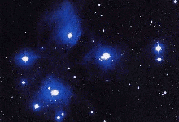
Space Complexity

Slide 2

Motivation
Complexity classes correspond to bounds on resources
One such resource is space: the number of tape cells a TM uses when solving a problem

Slide 3
Introduction
Objectives:
  To define space complexity classes
Overview:
  Space complexity classes
  Low space classes: L, NL
  Savitch’s Theorem
  Immerman’s Theorem
  TQBF

Slide 4
Space Complexity Classes
For any function f:N→R⁺, we define:
  SPACE(f(n))={ L : L is decidable by a
  deterministic O(f(n)) space TM}
  NSPACE(f(n))={ L : L is decidable by a
  non-deterministic O(f(n)) space TM}

Slide 5
Low Space Classes
Definitions (logarithmic space classes):
L = SPACE(logn)
NL = NSPACE(logn)

Slide 6
Problem!
How can a TM use only logn space if the input itself takes n cells?!
!?

Slide 7
3Tape Machines
input
work
output
a | a | b | a | b | b | _
. . .
read-only
Only the size of the work tape is counted for complexity purposes
read/
write
b | b | b | b | b | _ | _
. . .
write-only
b | a | a | b | a | _ | _
. . .

Slide 8
Example
Question: How much space would a TM that decides {a^{n}b^{n} | n>0} require?
Note: to count up to n, we need logn bits

Slide 9
Graph Connectivity
An undirected version is also worth considering
CONN
Instance: a directed graph G=(V,E) and two vertices s,t∈V
Problem: To decide if there is a path from s to t in G?

Slide 10
Graph Connectivity
t
s

Slide 11
CONN is in NL
Start at s
For i = 1, .., |V| {
  Non-deterministically choose a neighbor and jump to it
  Accept if you get to t
  }
If you got here – reject!
  Counting up to |V| requires log|V| space
  Storing the current position requires log|V| space

Slide 12

Log-Space Reductions
Definition:
A is log-space reducible to B, written A≤_{L}B,
if there exists a log space TM M that, given input w, outputs f(w) s.t.
w∈A iff f(w)∈B
the reduction

Slide 13
Do Log-Space Reductions Imply what they should?
Suppose A₁ ≤_{L} A₂ and A₂∈L; how to construct a log space TM which decides A₁?
Wrong Solution:
w
Too Large!
f(w)
Use the TM for A₂ to decide if f(w)∈A₂

Slide 14
Log-Space reductions
Claim: if
  A₁ ≤_{L} A₂ – f is the log-space reduction
  A₂ ∈ L – M is a log-space machine for A₂
Then, A₁ is in L
Proof: on input x, in or not-in A₁:
Simulate M and
whenever M reads the i^{th} symbol of its input tape
run f on x and wait for the i^{th} bit to be outputted

Slide 15
NL Completeness
Definition:
A language B is NL-Complete if
B∈NL
For every A∈NL, A≤_{L}B.
If (2) holds, B is NL-hard

Slide 16
CONN is NL-Complete
Theorem: CONN is NL-Complete
Proof: by the following reduction:
s
≤_{L}
t
“Does M accept x?”
“Is there a path from s to t?”

Slide 17
Technicality
Observation:
Without loss of generality, we can assume all NTM’s have exactly one accepting configuration.

Slide 18
Configurations Graph
A Computation of a NTM M on an input x can be described by a graph G_{M,x}:
A vertex per configuration
the start configuration
s
t
the accepting configuration
(u,v)∈E if M can move from u to v in one step

Slide 19
Configurations
Which objects determine the configuration of a TM of the new type?
The content of the work tape
The machine’s state
The head position on the input tape
The head position on the work tape
The head position on the output tape
If the TM uses logarithmic space, there are polynomially many configurations

Slide 20

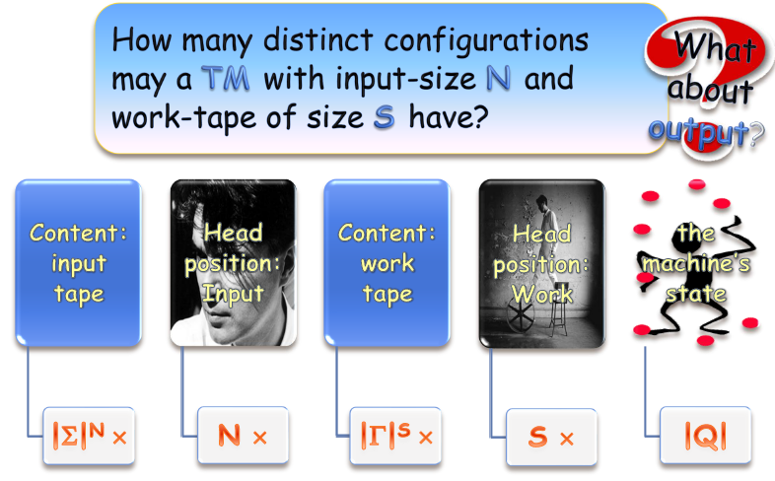
Configurations

Slide 21
Correctness
Claim: For every non-deterministic log-space Turing machine M and every input x,
M accepts x iff there is a path from s to t in G_{M,x}

Slide 22
CONN is NL-Complete
Corollary: CONN is NL-Complete
Proof: We’ve shown CONN is in NL. We’ve also presented a reduction from any NL language to CONN which is computable in log space (Why?) 

Slide 23
A Byproduct
Claim: NL⊆P
Proof:
Any NL language is log-space reducible to CONN
Thus, any NL language is poly-time reducible to CONN
CONN is in P
Thus any NL language is in P. 

Slide 24
Savitch’s Theorem
Theorem:
∀S(n) ≥ log(n)
NSPACE(S(n)) ⊆ SPACE(S(n)²)
Proof:
First we’ll prove NL⊆SPACE(log²n)
then, show this implies the general case

Slide 25
Savitch’s Theorem
Theorem:
NSPACE(logn) ⊆SPACE(log²n)
Proof:
First prove CONN is NL-complete (under log-space reductions)
Then show an algorithm for CONN that uses log²n space

Slide 26
What Next?
We need to show CONN can be decided by a deterministic TM in O(log²n) space.

Slide 27
The Trick
“Is there a path from u to v of length d?”
“Is there a vertex z, so there is a path from u to z of size ⎣d/2⎦ and one from z to v of size ⎡d/2⎤?”
⎣d/2⎦
⎡d/2⎤
u
z
v
. . .
d

Slide 28
Recycling Space
The two recursive invocations can use the same space

Slide 29
The Algorithm
Boolean PATH(a,b,d) {
if there is an edge from a to b then
    return TRUE
else {
if d=1 return FALSE
for every vertex v {
if PATH(a,v, ⎡d/2⎤) and PATH(v,b, ⎣d/2⎦)
then return TRUE
}
return FALSE
}
}

Slide 30
Example of Savitch’s algorithm
boolean PATH(a,b,d) {
if there is an edge from a to b then
return TRUE
else {
if (d=1) return FALSE
for every vertex v (not a,b) {
if PATH(a,v, ⎡d/2⎤) and
PATH(v,b, ⎣d/2⎦) then
return TRUE
}
return FALSE
}
}
boolean PATH(a,b,d) {
if there is an edge from a to b then
return TRUE
else {
if (d=1) return FALSE
for every vertex v (not a,b) {
if PATH(a,v, ⎡d/2⎤) and
PATH(v,b, ⎣d/2⎦) then
return TRUE
}
return FALSE
}
}
boolean PATH(a,b,d) {
if there is an edge from a to b then
return TRUE
else {
if (d=1) return FALSE
for every vertex v (not a,b) {
if PATH(a,v, ⎡d/2⎤) and
PATH(v,b, ⎣d/2⎦) then
return TRUE
}
return FALSE
}
}
boolean PATH(a,b,d) {
if there is an edge from a to b then
return TRUE
else {
if (d=1) return FALSE
for every vertex v (not a,b) {
if PATH(a,v, ⎡d/2⎤) and
PATH(v,b, ⎣d/2⎦) then
return TRUE
}
return FALSE
}
}
boolean PATH(a,b,d) {
if there is an edge from a to b then
return TRUE
else {
if (d=1) return FALSE
for every vertex v (not a,b) {
if PATH(a,v, ⎡d/2⎤) and
PATH(v,b, ⎣d/2⎦) then
return TRUE
}
return FALSE
}
}
boolean PATH(a,b,d) {
if there is an edge from a to b then
return TRUE
else {
if (d=1) return FALSE
for every vertex v (not a,b) {
if PATH(a,v, ⎡d/2⎤) and
PATH(v,b, ⎣d/2⎦) then
return TRUE
}
return FALSE
}
}
boolean PATH(a,b,d) {
if there is an edge from a to b then
return TRUE
else {
if (d=1) return FALSE
for every vertex v (not a,b) {
if PATH(a,v, ⎡d/2⎤) and
PATH(v,b, ⎣d/2⎦) then
return TRUE
}
return FALSE
}
}
boolean PATH(a,b,d) {
if there is an edge from a to b then
return TRUE
else {
if (d=1) return FALSE
for every vertex v (not a,b) {
if PATH(a,v, ⎡d/2⎤) and
PATH(v,b, ⎣d/2⎦) then
return TRUE
}
return FALSE
}
}
boolean PATH(a,b,d) {
if there is an edge from a to b then
return TRUE
else {
if (d=1) return FALSE
for every vertex v (not a,b) {
if PATH(a,v, ⎡d/2⎤) and
PATH(v,b, ⎣d/2⎦) then
return TRUE
}
return FALSE
}
}
boolean PATH(a,b,d) {
if there is an edge from a to b then
return TRUE
else {
if (d=1) return FALSE
for every vertex v (not a,b) {
if PATH(a,v, ⎡d/2⎤) and
PATH(v,b, ⎣d/2⎦) then
return TRUE
}
return FALSE
}
}
boolean PATH(a,b,d) {
if there is an edge from a to b then
return TRUE
else {
if (d=1) return FALSE
for every vertex v (not a,b) {
if PATH(a,v, ⎡d/2⎤) and
PATH(v,b, ⎣d/2⎦) then
return TRUE
}
return FALSE
}
}
boolean PATH(a,b,d) {
if there is an edge from a to b then
return TRUE
else {
if (d=1) return FALSE
for every vertex v (not a,b) {
if PATH(a,v, ⎡d/2⎤) and
PATH(v,b, ⎣d/2⎦) then
return TRUE
}
return FALSE
}
}
boolean PATH(a,b,d) {
if there is an edge from a to b then
return TRUE
else {
if (d=1) return FALSE
for every vertex v (not a,b) {
if PATH(a,v, ⎡d/2⎤) and
PATH(v,b, ⎣d/2⎦) then
return TRUE
}
return FALSE
}
}
boolean PATH(a,b,d) {
if there is an edge from a to b then
return TRUE
else {
if (d=1) return FALSE
for every vertex v (not a,b) {
if PATH(a,v, ⎡d/2⎤) and
PATH(v,b, ⎣d/2⎦) then
return TRUE
}
return FALSE
}
}
2
3
1
4
(a,b,c)=Is there a path from a to b, that takes no more
than c steps.
(1,4,3)(2,4,1)
(1,4,3)(1,3,2)(1,2,1)TRUE
(1,4,3)(1,3,2)(1,2,1)
(1,4,3)(3,4,1)TRUE
(1,4,3)(1,3,2)
(1,4,3)(1,2,2)TRUE
(1,4,3)(1,3,2)(2,3,1)
(1,4,3)(1,2,2)
(1,4,3)(2,4,1)FALSE
(1,4,3) TRUE
(1,4,3)
(1,4,3)(1,3,2)(2,3,1)TRUE
(1,4,3)(3,4,1)
(1,4,3)(1,3,2)TRUE
3Log₂(d)

Slide 31
O(log²n) Space DTM
Claim: There is a deterministic TM which decides CONN in O(log²n) space.
Proof:
To solve CONN, we invoke PATH(s,t,|V|)
The space complexity:
S(n)=S(n/2)+O(logn)=O(log²n) 

Slide 32
Conclusion
Theorem:
NSPACE(logn) ⊆SPACE(log²n)
How about the general case NSPACE(S(n))⊆SPACE(S²(n))?

Slide 33
The Padding Argument
Motivation: Scaling-Up Complexity Claims
We have:
can be simulated by…
space
space
+ non-determinism
+ determinism
We want:
can be simulated by…
space
space
+ non-determinism
+ determinism

Slide 34
Formally
s_{i}(n) can be computed with space s_{i}(n)
Claim: For any two space constructible functions s₁(n),s₂(n)≥logn, f(n)≥n:
NSPACE(s₁(n)) ⊆ SPACE(s₂(n))
⇓
NSPACE(s₁(f(n))) ⊆ SPACE(s₂(f(n)))
simulation overhead
E.g NSPACE(n)⊆SPACE(n²) ⇒ NSPACE(n²)⊆SPACE(n⁴)

Slide 35
Idea
space: s₁(.) in the size of its input
DTM
space: O(s₂(f(n)))
NTM
n
n
.
.
.
.
.
.
.
.
.
space: O(s₁(f(n)))
f(n)
0
.
.
.
.
.
.
.
0

Slide 36
Padding argument
Let L∈NPSPACE(s₁(f(n)))
There is a 3-Tape-NTM M_{L}:
|x|
Input
babba⎦
Work
⎦
O(s₁(f(|x|)))

Slide 37
Padding argument
Let L’ = { x0^{f(|x|)-|x|} | x∈L }
We’ll show a NTM M_{L’} which decides L’ in the same number of cells as M_{L}.
f(|x|)
Input
babba#00000000000000000000000000000000⎦
Work
⎦
O(s₁(f(|x|))

Slide 38
Padding argument – M_{L’}
In O(log(f(|x|)) space
Count backwards the number of 0’s and check there are f(|x|)-|x| such.
2. Run M_{L} on x.
in O(s₁(f(|x|))) space
f(|x|)
Input
babba00000000000000000000000000000000⎦
Work
⎦
O(s₁(f(|x|)))

Slide 39
Padding argument
Total space: O(s₁(f(|x|)))
f(|x|)
Input
babba00000000000000000000000000000000⎦
Work
⎦
O(s₁(f(|x|)))

Slide 40
Padding Argument
We started with L∈NSPACE(s₁(f(n)))
We showed: L’∈NSPACE(s₁(n))
Thus, L’∈SPACE(s₂(n))
Using the DTM for L’ we’ll construct a DTM for L, which will work in O(s₂(f(n))) space.

Slide 41
Padding Argument
The DTM for L will simulate the DTM for L’ when working on its input concatenated with zeros
Input
babba⎦
00000000000000000000000

Slide 42
Padding Argument
When the input head leaves the input part, just pretend it encounters 0s.
maintaining the simulated position (on the imaginary part of the tape) takes O(log(f(|x|))) space.
Thus our machine uses O(s₂(f(|x|))) space.
⇒ NSPACE(s₁(f(n)))⊆SPACE(s₂(f(n)))

Slide 43
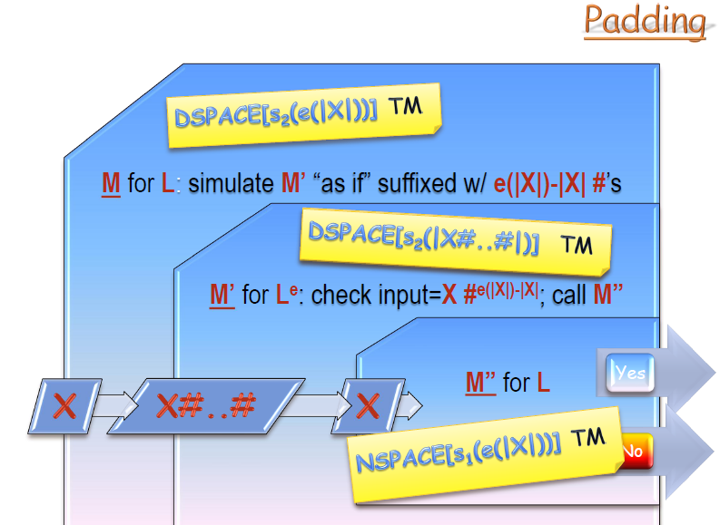
Padding Argument

Slide 44
Savitch: Generalized Version
Theorem (Savitch):
∀S(n) ≥ log(n)
NSPACE(S(n)) ⊆ SPACE(S(n)²)
Proof: We proved NL⊆SPACE(log²n). The theorem follows from the padding argument. 

Slide 45
Corollary
Corollary: PSPACE = NPSPACE
Proof:
Clearly, PSPACE⊆NPSPACE.
By Savitch’s theorem, NPSPACE⊆PSPACE. 

Slide 46
Space Vs. Time
We’ve seen space complexity probably doesn’t resemble time complexity:
  Non-determinism doesn’t decrease the space complexity drastically (Savitch’s theorem).
We’ll next see another difference:
  Non-deterministic space complexity classes are closed under completion (Immerman’s theorem).

Slide 47
NON-CONN
NON-CONN
Instance: A directed graph G and two vertices s,t∈V.
Problem: To decide if there is no path from s to t.

Slide 48
NON-CONN
Clearly, NON-CONN is coNL-Complete.
(Because CONN is NL-Complete. See the coNP lecture)
If we’ll show it is also in NL, then NL=coNL.
(Again, see the coNP lecture)

Slide 49
An Algorithm for NON-CONN
We’ll see a log space algorithm for counting reachability
Count how many vertices are reachable from s.
Take out t and count again.
Accept if the two numbers are the same.

Slide 50
N.D. Algorithm for reach_{s}(v, l)
reach_{s}(v, l)
1. length = l; u = s
2. while (length > 0) {
3. if u = v return ‘YES’
4. else, for all (u’ ∈ V) {
5. if (u, u’) ∈E nondeterministic switch:
5.1 u = u’; --length; break
5.2 continue
}
}
6. return ‘NO’
Takes up logarithmic space
This N.D. algorithm might never stop

Slide 51
N.D. Algorithm for CR_{s}
CR_{s} ( d )
1. count = 0
2. for all u∈V {
3. count_{d-1} = 0
4. for all v∈V {
5. nondeterministic switch:
5.1 if reach(v, d - 1) then ++count_{d-1} else fail
if (v,u) ∈ E then ++count; break
  5.2 continue
}
6. if count_{d-1} < CR_{s} (d-1) fail
}
7.return count
Assume (v,v) ∈ E
Recursive call!

Slide 52
N.D. Algorithm for CR_{s}
, C)
Main Algorithm:
CR_{s}
C = 1
for d = 1..|V|
C = CR(d, C)
return C
CR_{s} ( d
1. count = 0
2. for all u∈V {
3. count_{d-1} = 0
4. for all v∈V {
5. nondeterministic switch:
5.1 if reach(v, d - 1) then ++count_{d-1} else fail
if (v,u) ∈ E then ++count; break
  5.2 continue
}
6. if count_{d-1} < fail
}
7.return count
C
parameter

Slide 53
Efficiency
Lemma: The algorithm uses O(log(n)) space.
Proof:
There is a constant number of variables ( d, count, u, v, count_{d-1}). Each requires O(log(n)) space (range |V|). 

Slide 54
Immerman’s Theorem
Theorem[Immerman/Szelepcsenyi]: NL=coNL
Proof:
(1) NON-CONN is NL-Complete
(2) NON-CONN∈NL
Hence, NL=coNL. 

Slide 55
Corollary
Corollary:
∀s(n)≥log(n), NSPACE(s(n))=coNSPACE(s(n))
Proof: By a padding argument.

Slide 56
TQBF
We can use the insight of Savich’s proof to show a language which is complete for PSPACE.
We present TQBF, which is the quantified version of SAT.

Slide 57
TQBF
Instance: a fully quantified Boolean formula φ
Problem: to decide if φ is true
Example: a fully quantified Boolean formula
∀x∃y∀z[(x∨¬y∨z)∧(¬x∨y)]
Variables` range is {0,1}

Slide 58
TQBF is in PSPACE
Theorem: TQBF∈PSPACE
Proof: We’ll describe a poly-space algorithm A for evaluating φ:
If φ has no quantifiers: evaluate it
If φ=∀x(ψ(x)) call A on ψ(0) and on ψ(1); Accept if both are true.
If φ=∃x(ψ(x)) call A on ψ(0) and on ψ(1); Accept if either is true.
in poly time

Slide 59
Algorithm for TQBF
1
∀x∃y[(x∨¬y)∧(¬x∨y)]
1
1
∃y[(0∨¬y)∧(¬0∨y)]
∃y[(1∨¬y)∧(¬1∨y)]
(0∨¬0)∧(¬0∨0)
(0∨¬1)∧(¬0∨1)
(1∨¬0)∧(¬1∨0)
(1∨¬1)∧(¬1∨1)
1
0
0
1

Slide 60
Efficiency
Since both recursive calls use the same space,
the total space needed is polynomial in the number of variables (the depth of the recursion)
⇒ TQBF is polynomial-space decidable 

Slide 61
PSAPCE Completeness
Definition:
A language B is PSPACE-Complete if
B∈PSPACE
For every A∈PSAPCE, A≤_{P}B.
standard Karp reduction
If (2) holds, then B is PSPACE-hard

Slide 62
TQBF is PSPACE-Complete
Theorem: TQBF is PSAPCE-Complete
Proof: It remains to show TQBF is PSAPCE-hard:
≤_{P}
∀x₁∃x₂∀x₃…[…]
“Will the poly-space M accept x?”
“Is the formula true?”

Slide 63
TQBF is PSPACE-Hard
Given a TM M for a language L∈ PSPACE, and an input x, let f_{M,x}(u, v), for any two configurations u and v, be the function evaluating to TRUE iff M on input x moves from configuration u to configuration v
f_{M,x}(u, v) is efficiently computable

Slide 64
Formulating Connectivity
The following formula, over variables u,v∈V and path’s length d, is TRUE iff G has a path from u to v of length ≤d
φ(u,v,1) ≡ f_{M,x}(u, v) ∨ u=v
φ(u,v,d) ≡ ∃w∀x∀y[((x=u∧y=w)∨(x=w∧y=v))→φ(x,y,d/2)]
w is reachable from u in ⎡d/2⎤ steps. v is reachable from w in ⎡d/2⎤ steps.
simulates AND of φ(u,w,d/2) and φ(w,v,d/2)

Slide 65
TQBF is PSPACE-Complete
Claim: TQBF is PSPACE-Complete
Proof:
φ ≡ φ(s,t,|V|) is TRUE iff there is a path from s to t.
φ is constructible in poly-time.
Thus, any PSPACE language is poly-time reducible to TQBF, i.e – TQBF is PSAPCE-hard.
Since TQBF∈PSPACE, it’s PSAPCE-Complete. 

Slide 66
Summary
◉
We introduced a new way to classify problems: according to the space needed for their computation.
We defined several complexity classes: L, NL, PSPACE.

Slide 67
Summary
◉
Our main results were:
  Connectivity is NL-Complete
  TQBF is PSPACE-Complete
  Savitch’s theorem (NL⊆SPACE(log²))
  The padding argument (extending results for space complexity)
  Immerman’s theorem (NL=coNL)
By reducing decidability to reachability

